Slide 1
Mid Defense
Project Title: Canteen Pre-booking System
(Click2Eat)
Group Members:
Shulabh Shrestha
Raja Mandal
Aaishwarya Prashant
Saistha Pradhan

Slide 2
Introduction
A web-based system that lets students browse categorized food items, view “Today’s Special,” and place quick one-click orders.
Provides real-time order tracking (pending, preparing, ready, cancelled) and reduces waiting time.
Admin can manage menu, mark items as sold out, and update order status, while payment is done physically at the canteen.

Slide 3
Objectives
To enable quick and easy pre-ordering of food for students
To enable admins to manage menu items, food availability, and real-time order processing
To provide clear tracking of order status

Slide 4
Scope
Digital menu with admin-controlled “Today’s special”
One click ordering system with confirmation or undo and real time order status tracking
Admin dashboard to manage orders, mark items as sold out and update “Paid and collected”

Slide 5
Feasibility Study
Technical Feasibility: Easily developed using basic web technologies with no complex requirements.
Operational Feasibility: Simple for students and staff to use, improving canteen workflow.
Economic Feasibility: Low-cost or open source system with high efficiency benefits.

Slide 6
Tools and Techniques
Git and GitHub for collaborations and backlog
Draw.io for making UML Diagrams
PHP will be our primary programming language(Front&Backend)
Figma for website structure and interaction simulation (link)

Slide 7
Expected Outcome
Students able to pre-order to avoid long waiting queues
Real-time order tracking helps staff prepare only what’s needed.
Improved inventory control with “Sold out” system.

Slide 8
Literature Review
1. QR-Based Canteen System
Authors: G. K. Patil et al. Summary: Uses QR code to access menu and place orders, reducing waiting time. Knowledge Gap: Requires QR setup and lacks real-time tracking and simple usability.

Slide 9
2. Android-Based Canteen Ordering System
Authors: S. N. Patil et al. Summary: Mobile app for ordering food, helps reduce queue during peak time. Knowledge Gap: Requires app installation and not accessible for all users.

Slide 10
3. Smart Canteen Management System
Authors: R. K. Sharma et al. Summary: Provides digital ordering and management features. Knowledge Gap: Complex system, focuses on online payment rather than simple solutions.

Slide 11
Methodology
The proposed Canteen Pre-booking System is developed using the Waterfall Model, where each phase is completed step-by-step in a sequential manner.
Requirement Analysis
System Design
Implementation
Testing
Deployment
Maintenance

Slide 12
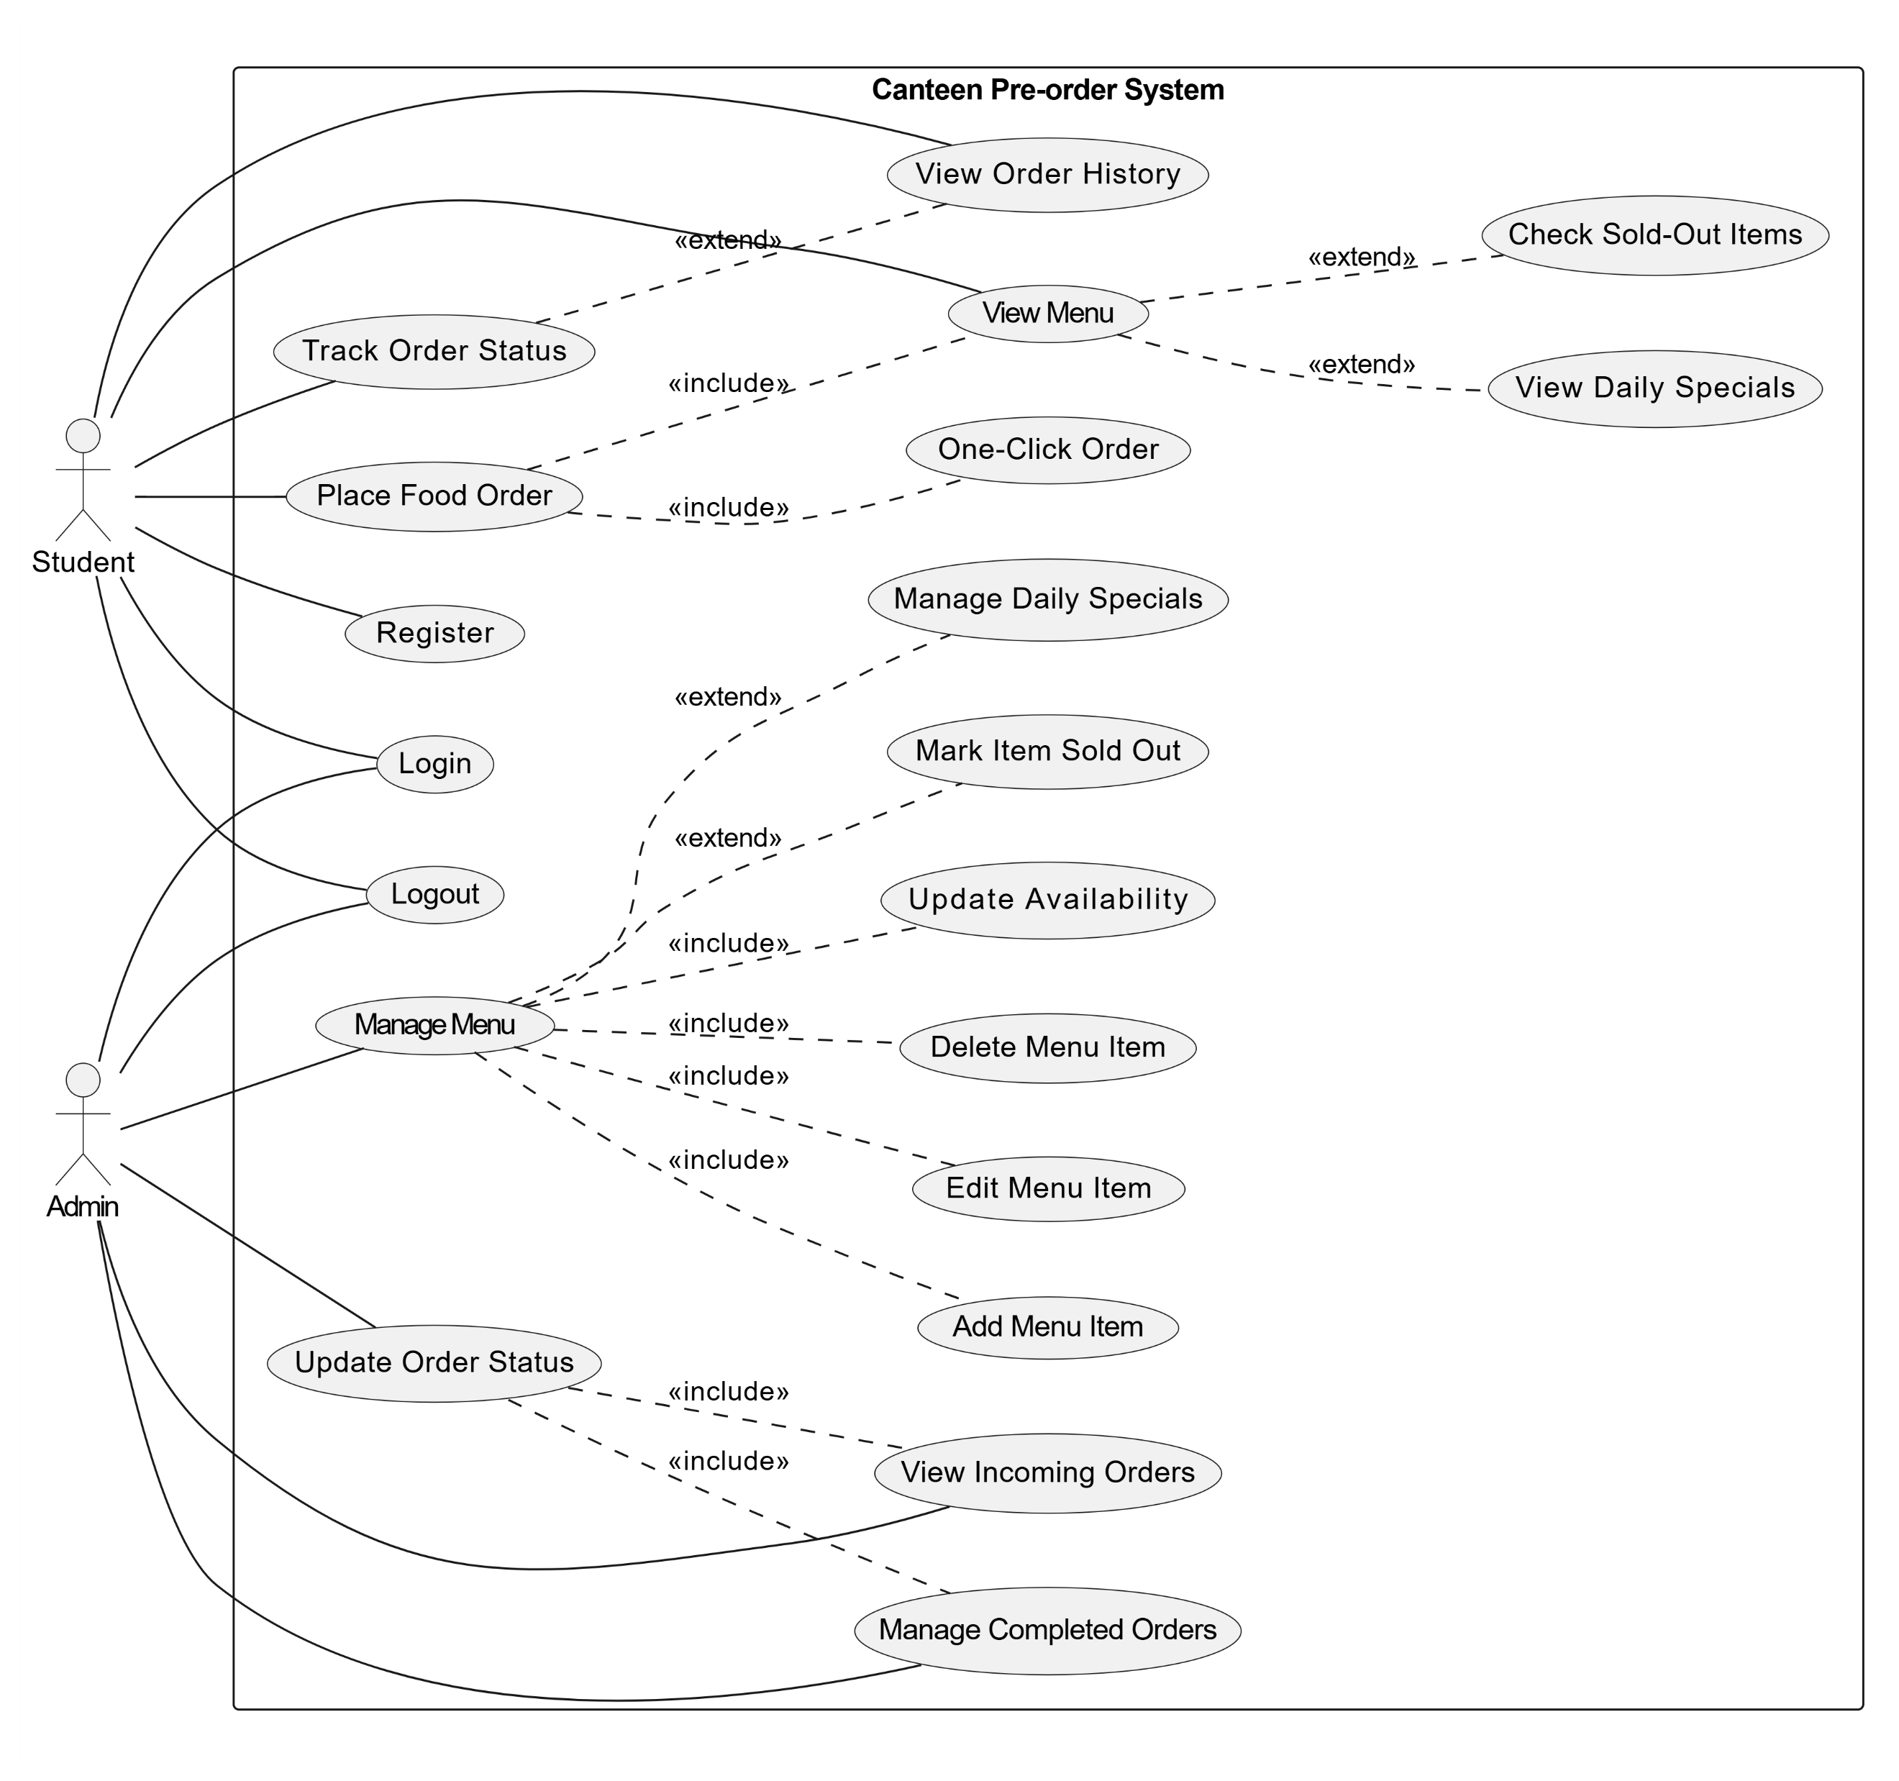
UML Diagrams
Use Case Diagram:

Slide 13
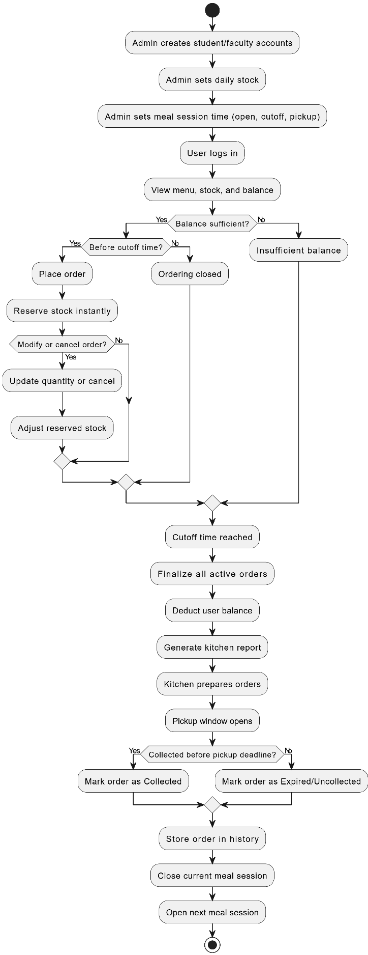
UML Diagrams
Activity Diagram:

Slide 14
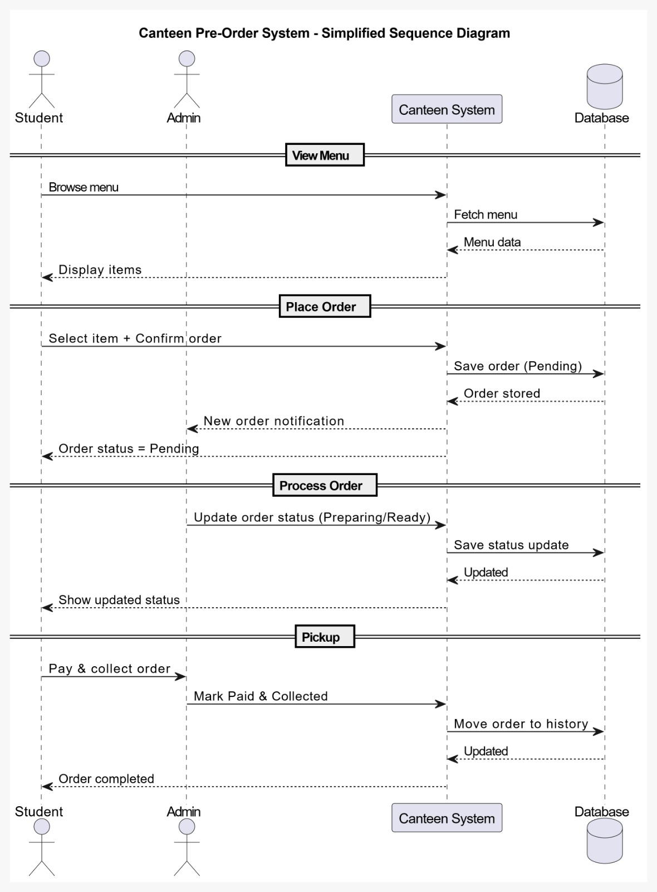
UML Diagrams
Sequence Diagram

Slide 15
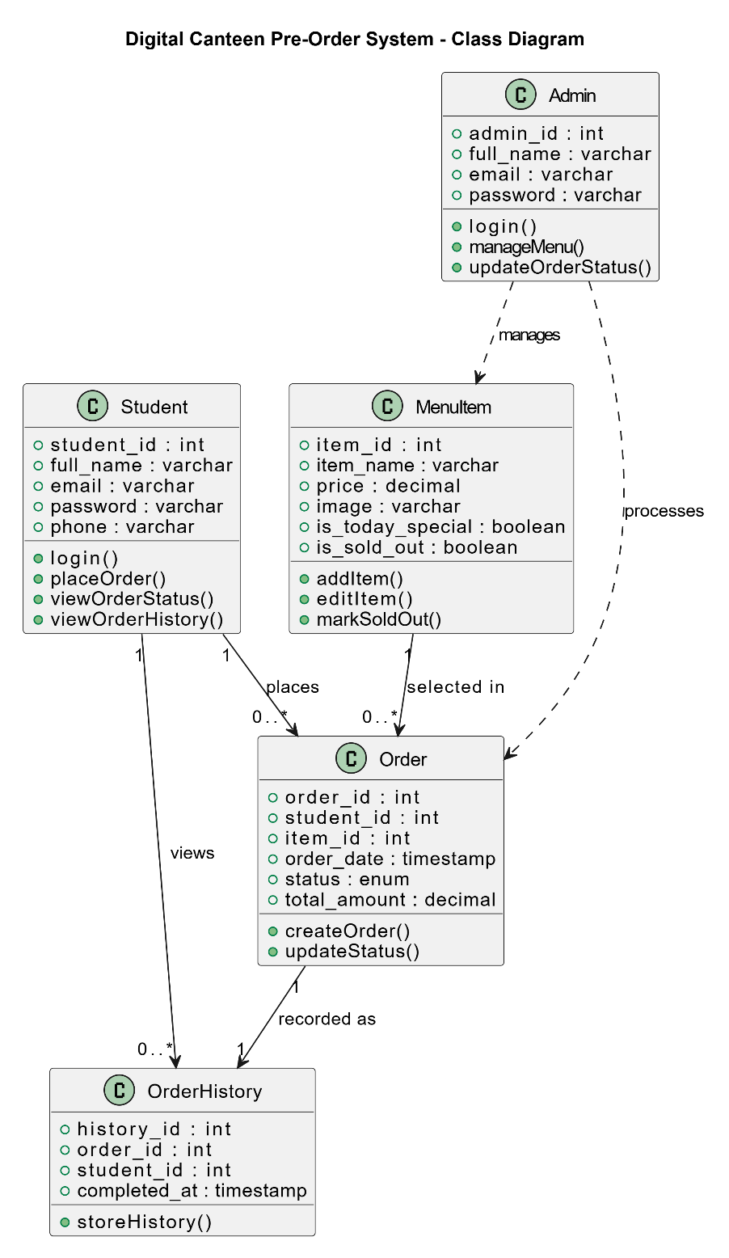
UML Diagrams
Class Diagram:

Slide 16
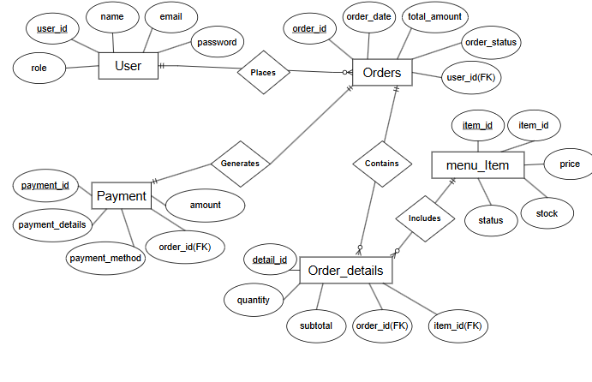
UML Diagrams
ER Diagram:

Slide 17
Timeline
1 | Title Defense
1.1 | Topic Brainstorming | 26-Apr | 26-Apr | 1
1.2 | Topic Decision | 27-Apr | 27-Apr | 1
1.3 | Presentation Preparation and Division | 28-Apr | 29-Apr | 2
2 | Proposal Defense
2.1 | Literature Review and Figma Designing | 30-Apr | 02-May | 3
2.2 | UML Diagrams | 03-May | 06-May | 4
2.3 | Backlog | 07-May | 07-May | 1
2.4 | Preparation of Documentation and Presentation | 08-May | 09-May | 2
3 | Mid-Term Defense
3.1 | Correction of Diagrams and Project Work Division | 14-May | 15-May | 2
3.2 | Gantt chart | 18-May | 18-May | 1
3.3 | Project Implementation Start
3.3.1 | Database Definition and Login/Signup Page | 20-May | 22-May | 3
3.3.2 | User Dashboard and Admin Dashboard redirection | 23-May | 24-May | 2
3.3.3 | Order Menu creation (For users) and Admin custom menu for daily "Today's special" unique menu | 26-May | 28-May | 3
3.3.4 | Order POST Logic and display order on admin side | 28-May | 29-May | 2
3.4 | Testing and Test Case Creation | 30-May | 02-Jun | 4
3.5 | Documentation Correction | 03-Jun | 04-Jun | 2
3.6 | Documentation for Mid-Term Defense Creation | 05-Jun | 08-Jun | 4
3.7 | Presentation Preparation and Division | 12-Jun | 13-Jun | 2
4 | Final Project Implementation
4.1 | Menu and Daily Stock Management | 15-Jun | 19-Jun | 5
4.2 | Reservation and One-Click Pre-order Module | 20-Jun | 24-Jun | 5
4.3 | Order History and Reservation Cancellation | 25-Jun | 27-Jun | 3
4.4 | Order Slot and Timing Schedule Management | 29-Jun | 03-Jul | 5
4.5 | Balance Recharge and Transaction Management | 04-Jul | 08-Jul | 5
4.6 | Reservation Finalization and Automatic Stock Deduction | 09-Jul | 13-Jul | 5
4.7 | Kitchen Report and Order Management | 14-Jul | 18-Jul | 5
4.8 | Admin Menu Editing and Menu Availability Management | 20-Jul | 22-Jul | 3
4.9 | System Integration and Bug Fixing | 23-Jul | 27-Jul | 5
4.10 | System Testing and Test Case Finalization | 28-Jul | 29-Jul | 2
4.11 | Documentation and Final Report Preparation | 30-Jul | 31-Jul | 2
4.12 | Final Presentation Preparation and Project Demonstration | 01-Aug | 01-Aug | 1

Slide 18
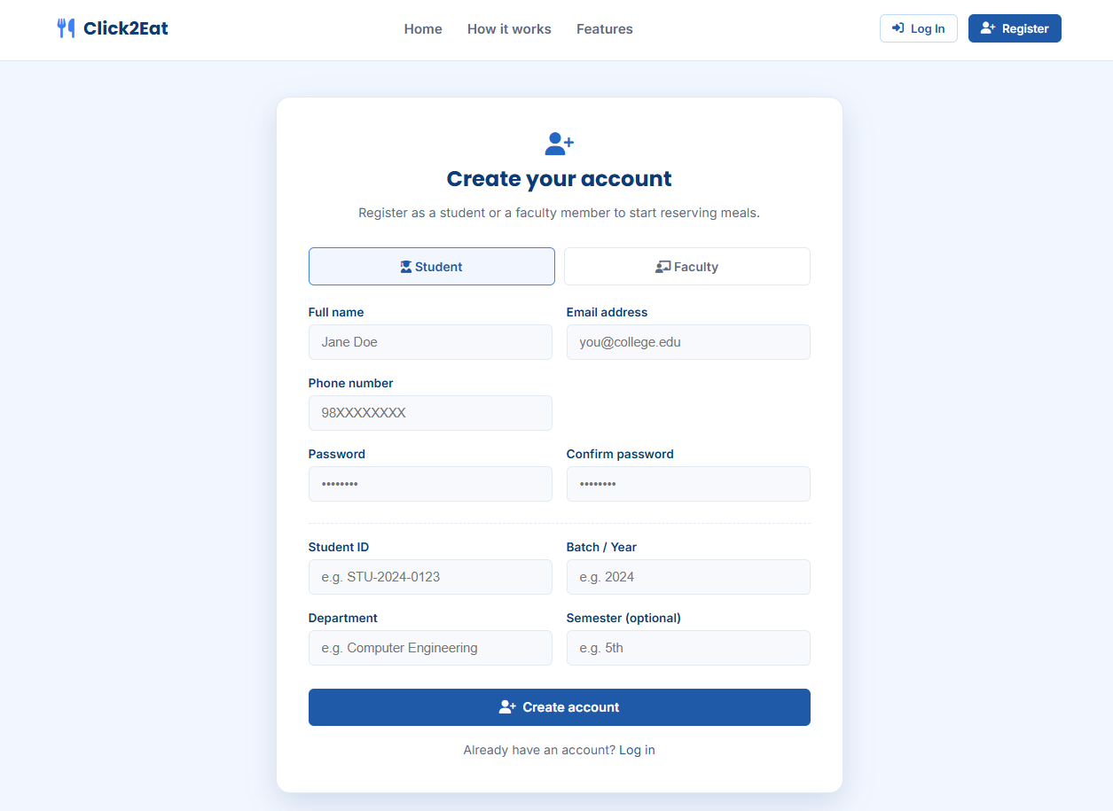
Screenshots
Register Page

Slide 19
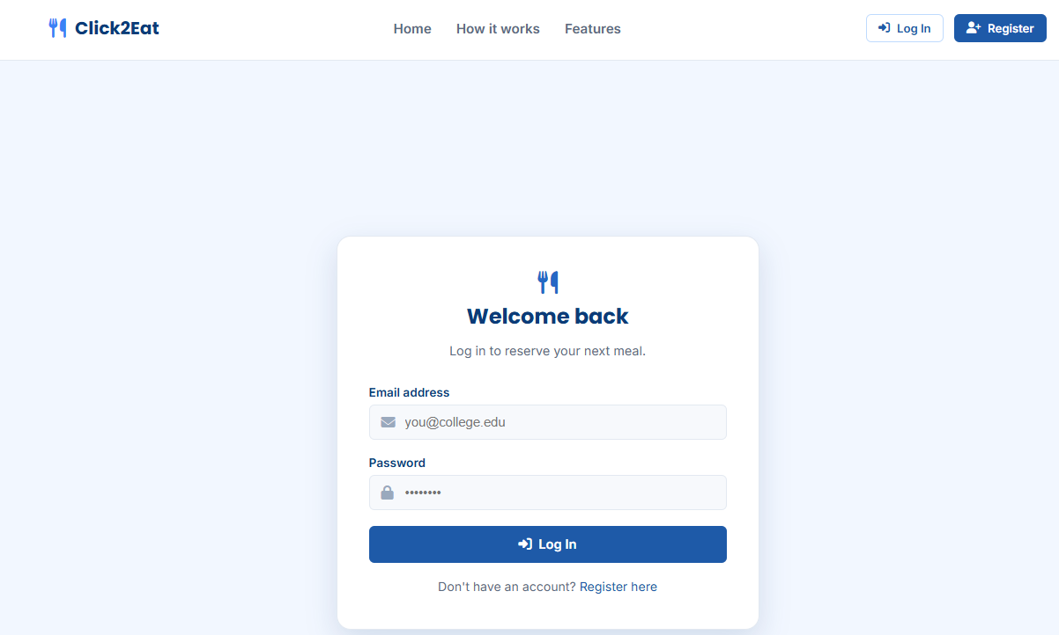
Screenshots
Login Page

Slide 20
Screenshots
Login Page

Slide 21
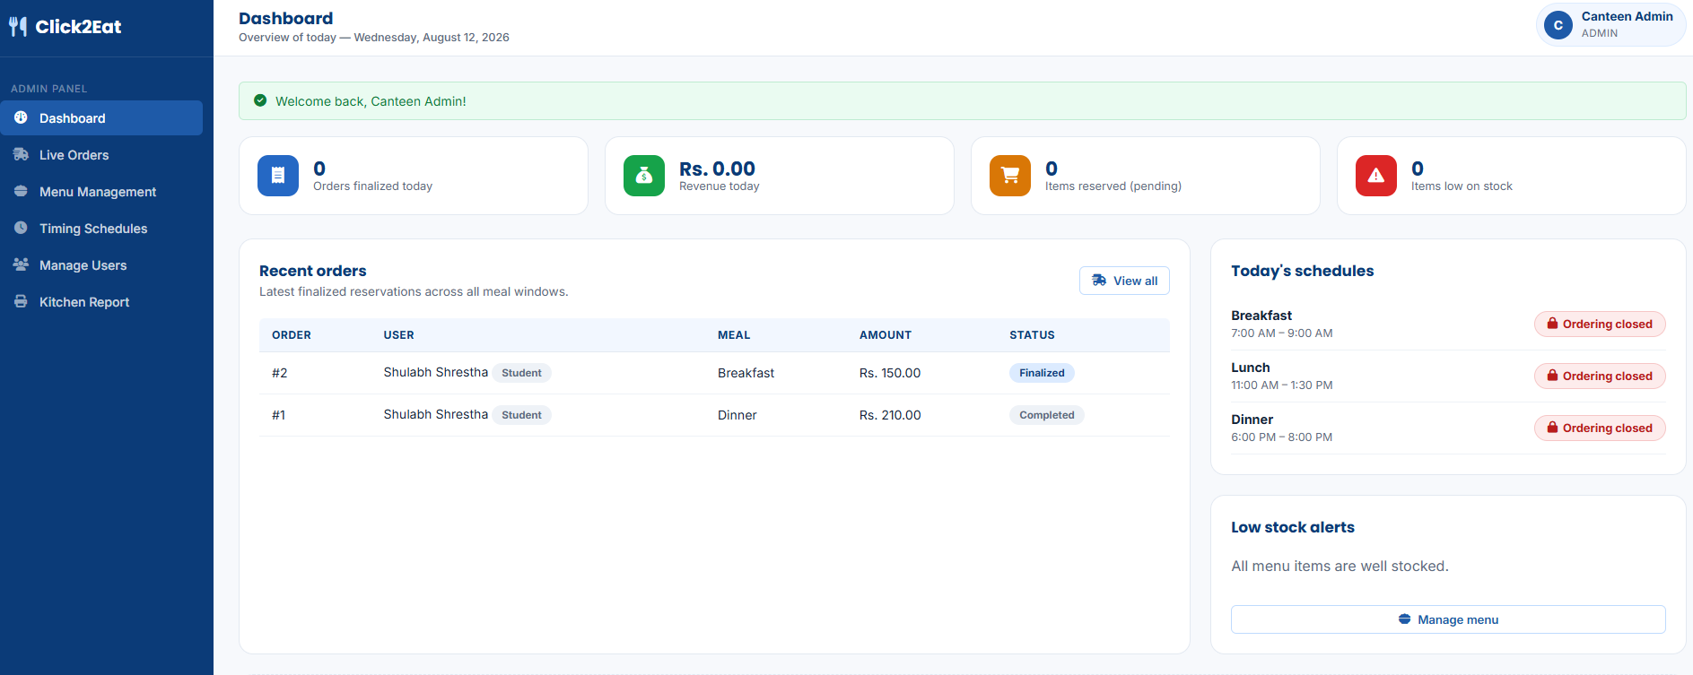
Screenshots
Admin Dashboard

Slide 22
Screenshots
Admin – Track Live Orders

Slide 23
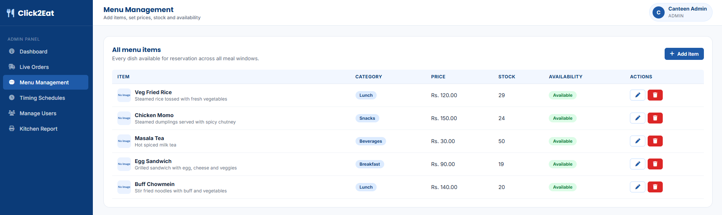
Screenshots
Admin – Menu Management

Slide 24
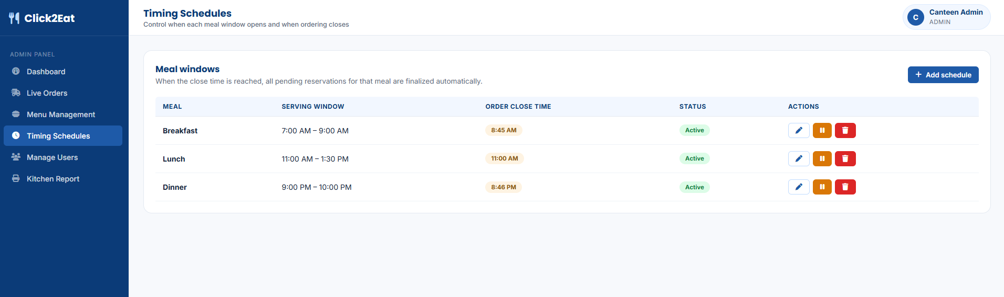
Screenshots
Admin – Timing Schedules

Slide 25
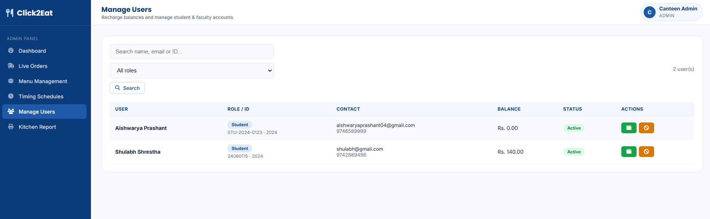
Screenshots
Admin – Manage Users

Slide 26
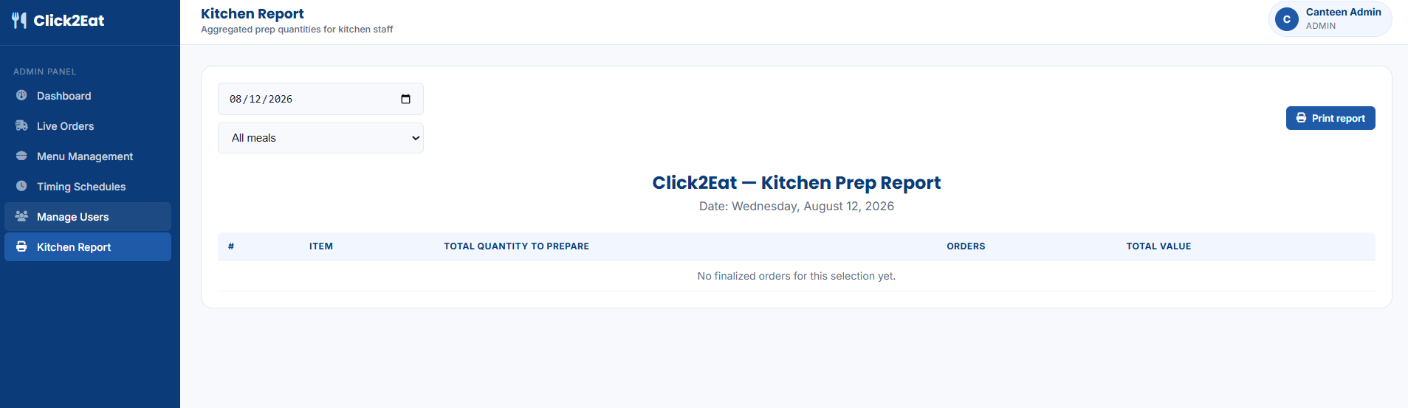
Screenshots
Admin – Kitchen Report Generation

Slide 27
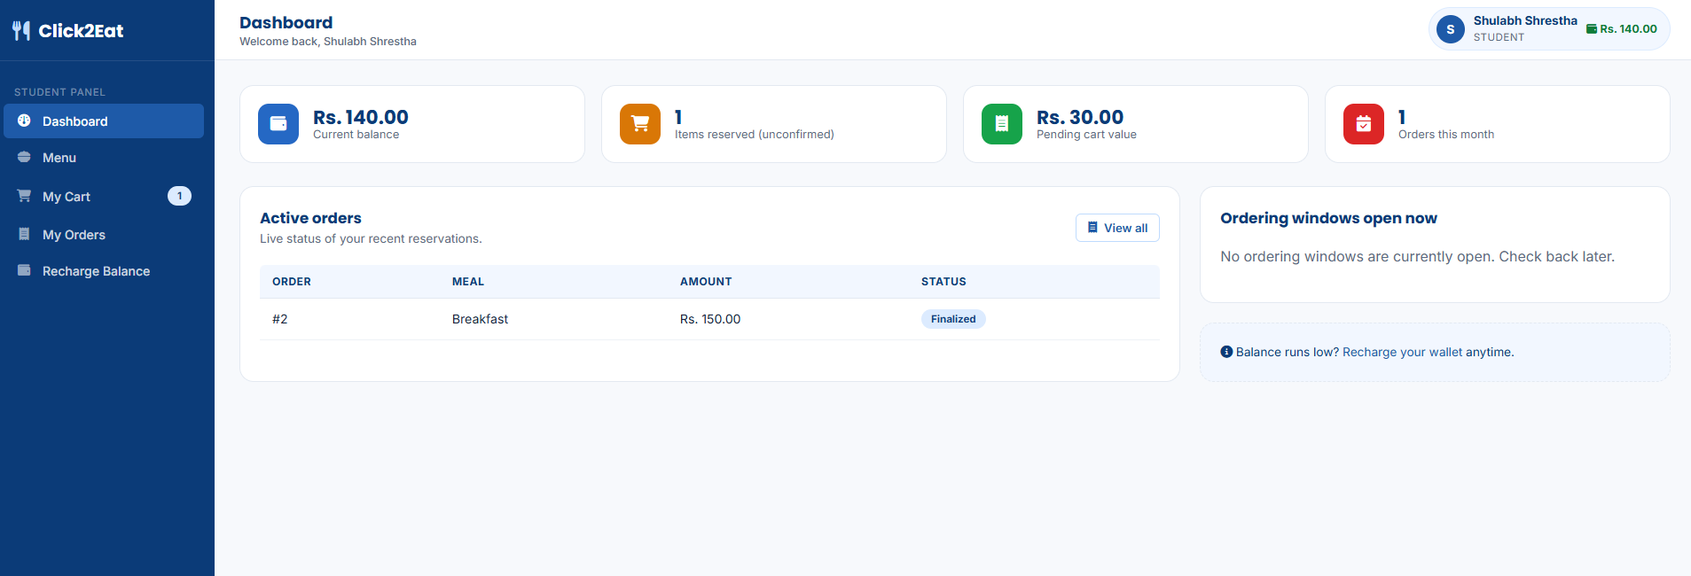
Screenshots
User – Dashboard

Slide 28
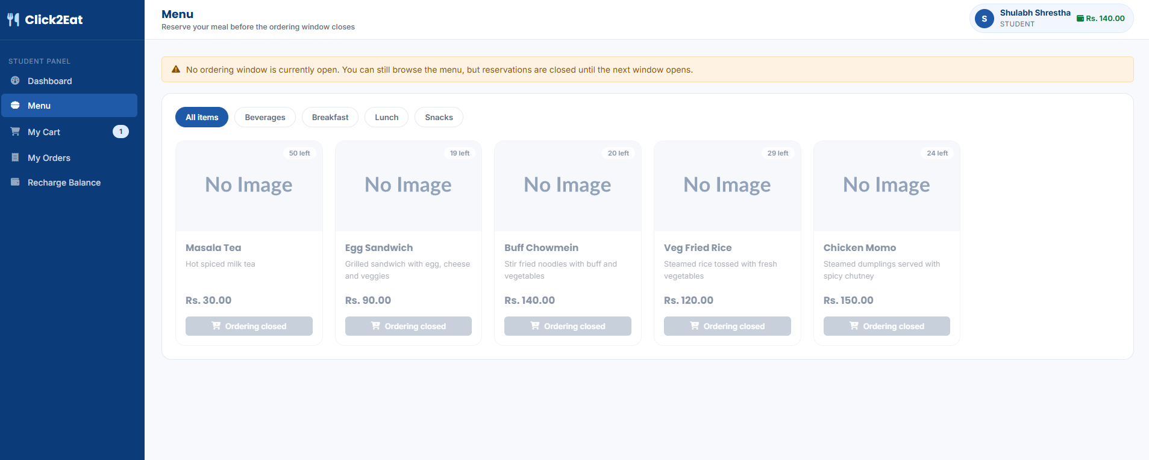
Screenshots
User – Menu

Slide 29
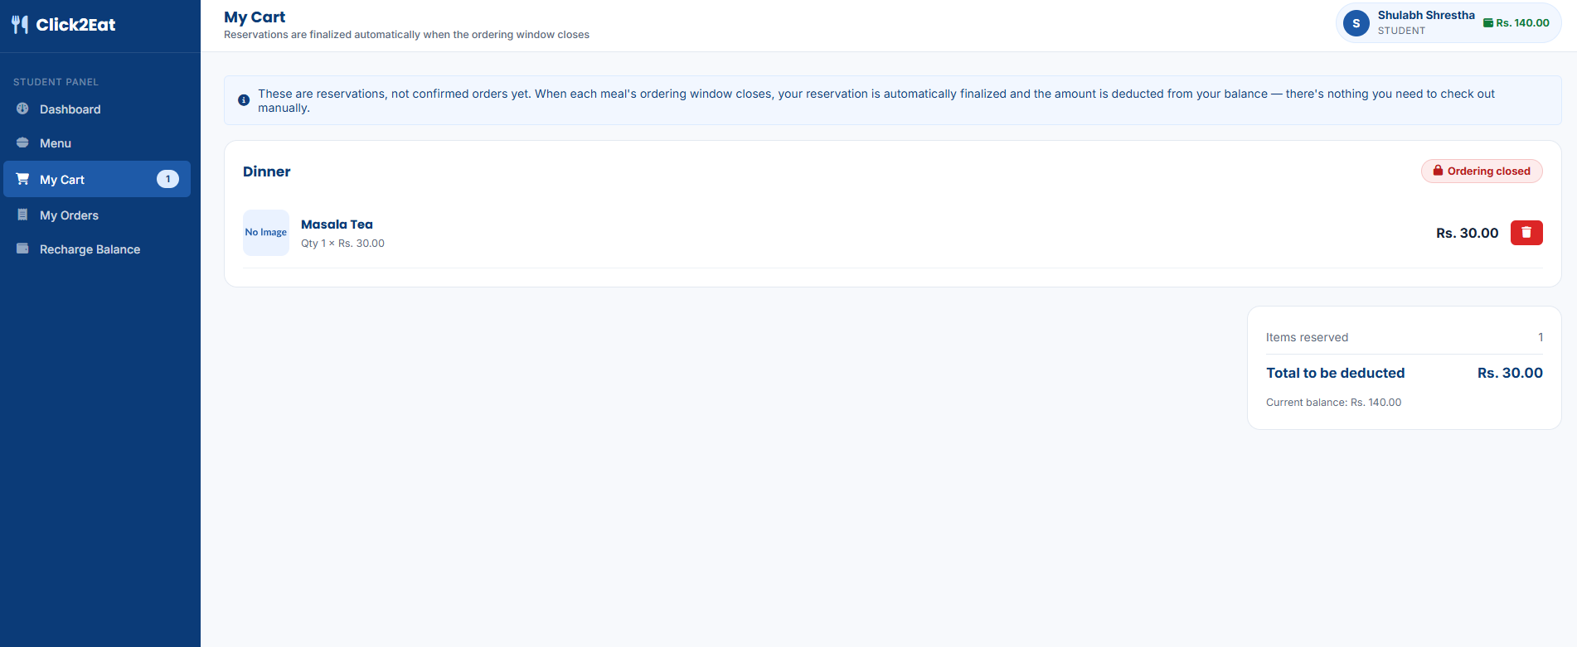
Screenshots
User – Cart

Slide 30
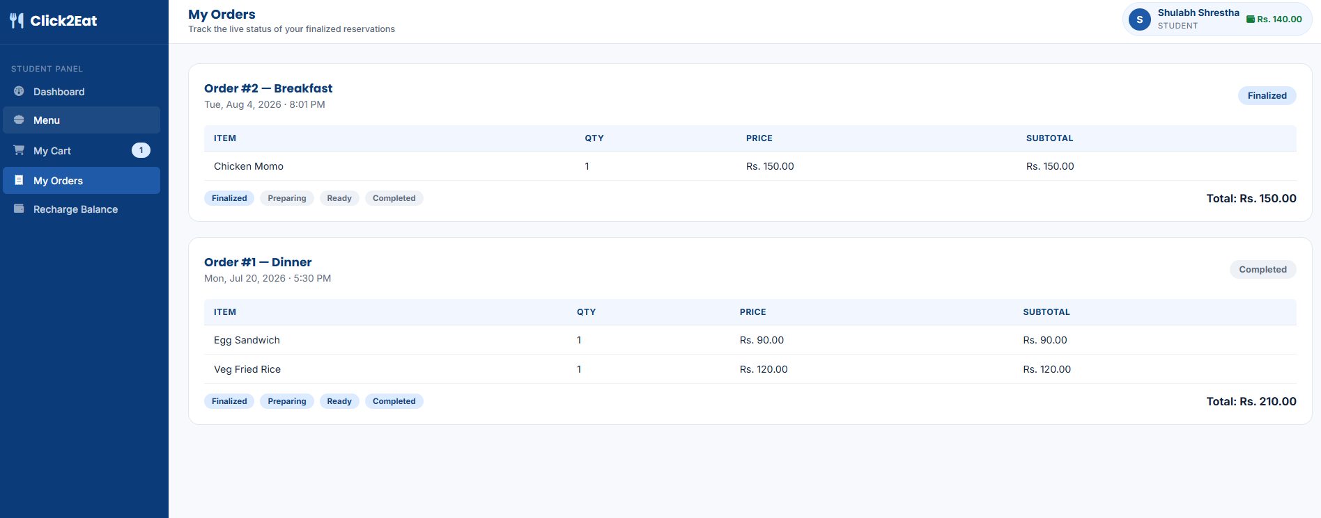
Screenshots
User – My Orders

Slide 31
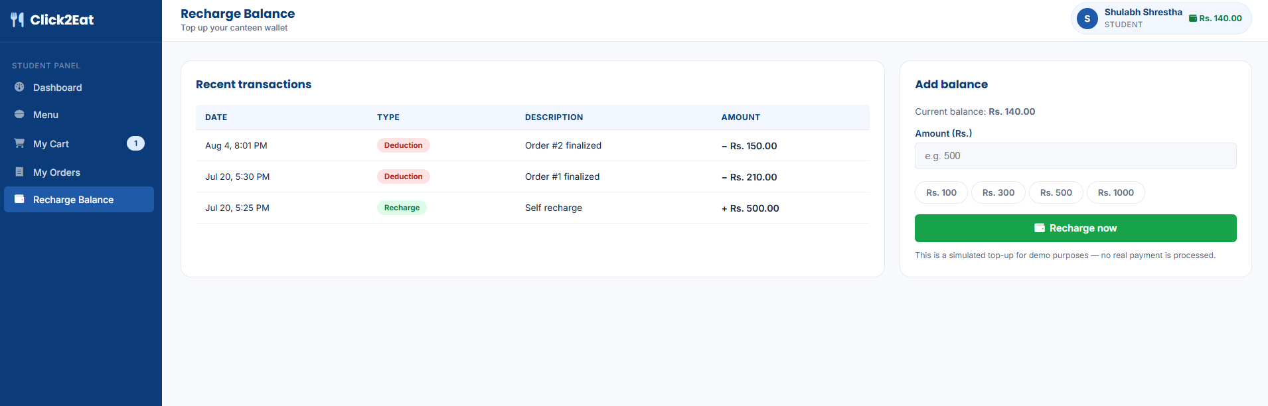
Screenshots
User – Recharge balance

Slide 32
Future Enhancements
• Mobile Application Integration Develop a mobile app (using React Native) to allow users to report issues instantly with push notifications and location-based services.
• Feedback and Rating System
Allow students to rate food and services
Help improve canteen quality

